Slide 1
Final Project Data Analytics
interesting insights from data

Slide 2
Your chance to shine
Put in practice what you have learned these past weeks
Showcase your skills
Part of you DA portfolio

Slide 3
Our chance to assess your skills
If need be: help you review items from the past weeks
Advise you on learning path going forward
Advise you in your job hunt

Slide 4
What do we want to see?
Insights and Information from Data
Formulate an interesting question
Find data to help you answer that question
Clean
Analyse
understand the problem
understand the data
Model
Present

Slide 5
Don’t be shy
you can do more than you think
Some Final projects from earlier colleagues:
Understand factors driving AirBnB pricing
Explore the relation between refugee flow and number of terrorist attack in a region
Estimate Customer Lifetime Value and define the factors driving that.
Recommender Systems (Books, Recipes)
Recognizing images of Ikea furniture
Voice recognition - male or female voice?
Musical genre recognition - country or hula?

Slide 6
We’re here for you
We will
Give feedback on your question and selected data
Help when you get stuck; directing you to the/an answer
Ask difficult questions
Ask you to explain your thought process and code
Help you with your final presentation
We will not
Create your project for you
Micromanage your time

Slide 7
Process
Plan (using Trello, so we can also see where you are)
Formulate question
Find data - Need to use at least two datasets, one of which is collected through scraping or use of an API
Clean data
Exploratory/Descriptive Analysis
Build model
does not need to be the focus of the project
could just be used as a tool, or to get a better understanding of the factors driving a particular outcome
Formulate conclusions / answers / propose further work
Prepare presentation
And practice this, maybe one-to-one
Present

Slide 8
Schedule
Week 8 (from Thursday afternoon) and 9 are dedicated to this project
We still do daily standups and games
Some optional workshops / sessions during the week
Same as always: discuss between yourselves, help each other, if that fails, we are there for you.
Project pitch on Thursday afternoon
Dataset pitch on Monday morning
Check-in every second day
We are always here for questions (during the day)
Presentation on Friday afternoon

Slide 9
Questions?
???????

Slide 10
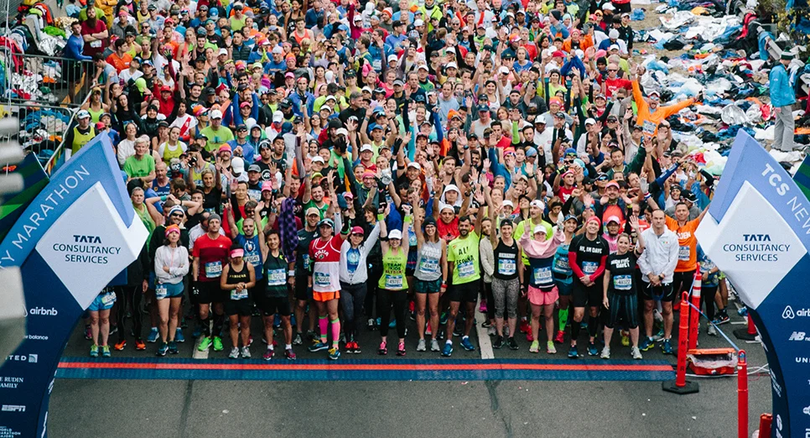
Let’s go!

